Slide 1

OiAIP & iPack ML Design Doc
David Crook | Sr. SDE
DaCrook@Microsoft.com

Slide 2
Responsibilities
OIAIP
iPack
OOB Models
Define Set of OOB Model Classes
Provision Required Resources & Provide Endpoints for
Upload data, get labelling tool url, train, get train runs & metrics, export & register model for target
Custom Models
Define specification for package format & config
Provision Resources & Provide Endpoints for
Upload data, get labelling tool url, train, get train runs & metrics, export & register model for target
Define ML Models Required
Define Workloads requiring models & expected model drop location.
Creating Interface Leveraging Resources & Endpoints provisioned by Platform
Implemented as part of admin app
Custom Models
Define Pipeline Package Location
Define class of pipeline (AML Pipes for example)
Labelling Tool as Docker Container

Slide 3
OOB Model Flow
ML APIS in OIAIP
Capture New Data for iPack
Get # Currently Staged Captured data for iPack
Train specific model in specific iPack with specific parameters
Get available parameters for model definition
get specific model’s train runs & metrics
export & register specific train run.
Get telemetry access information
Get captured data staging access information
Clear captured data staging store
OiAIp
Upload iPack

Slide 4
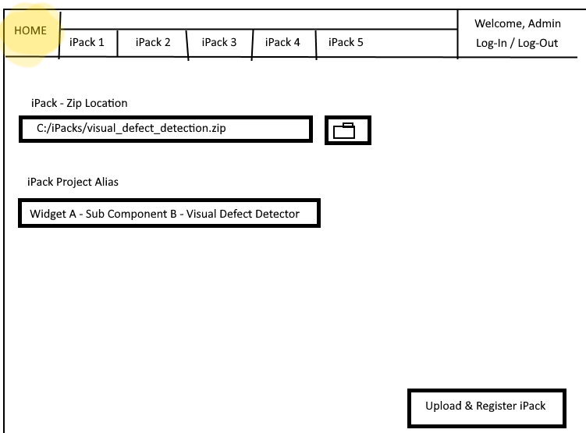
OIAIP Admin - iPack Registration Mock Up

Slide 5
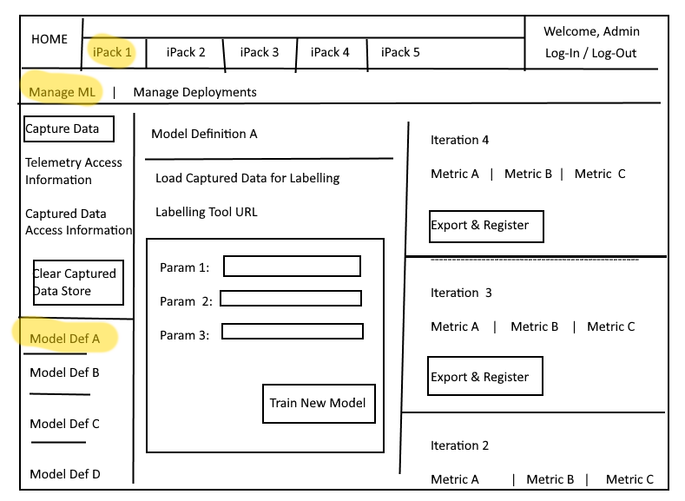
Initial iPack Mock Up

